Slide 1
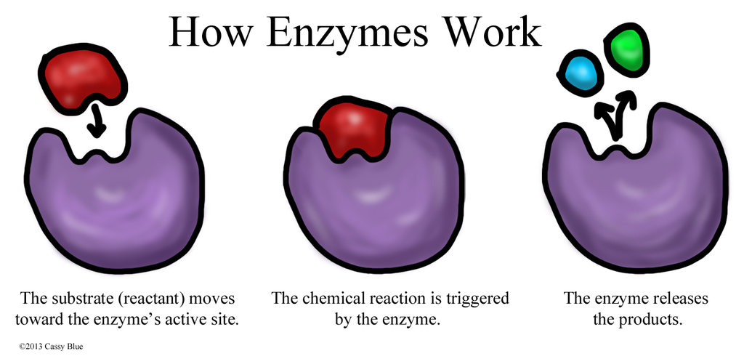
11ATAR Biology
Week 24 - Enzymes

Slide 2

Year 11 Biology Work Schedule
It is important to remain on schedule during this Semester.
Moodle
Have you visited Moodle this week? Yes / No
Tasks
Are you on schedule? Yes / No
When is your next task due?

Slide 3
Review
Identify the biologically important role of each molecule:
Lipids:
Carbohydrates:
Proteins:
Nucleic acids:
Notes:
Lipids: Insulation and concentrated source of energy, cellular membranes, water-proofing, organ protection (shock absorbing)
Carbohydrates: Energy (and storage), cell recognition, plant cell wall structural polymer
Proteins: structural, catalytic, movement, signalling, internal defence or transport of storage.
Nucleic Acids: encode information for the construction and functioning of an organism.

Slide 4
Learning Intentions
Understand:
biochemical processes in the cell are controlled by factors, including the nature and arrangement of internal membranes, and the presence of specific enzymes
Models used to explain the function of enzymes.
Success Criteria
Students will be able to:
Explain how enzyme function is effected by temperature, pH, presence of inhibitors, concentrations of reactants and products
Describe and illustrate the lock and key model and the induced fit model of enzyme action.

Slide 5
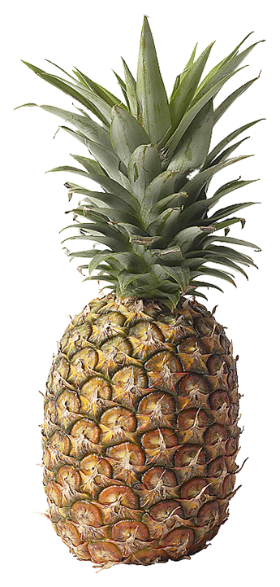
Enzymes
Enzymes are molecules that act as catalysts to speed up biological reactions.
Enzymes are not consumed during the reaction - used over and over again.
Enzymes can break a single structure into smaller components (catabolic reactions) or join two or more substrate molecules together (anabolic reactions).
Most enzymes are proteins.
Many fruits contain enzymes that are used in commercial processes. Pineapple (Ananas comosus, right) contains the enzyme papain which is used in meat tenderization processes and also medically as an anti-inflammatory agent.
Notes:
Not consumed means they can be re-used over and over again, which is good because then we only need low concentrations of enzymes.

Slide 6
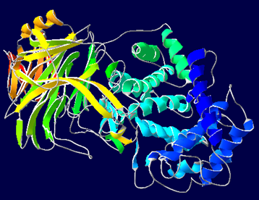
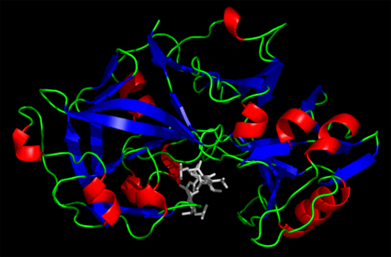
Enzymes - examples
Enzyme | Role
Pepsin | Stomach enzyme used to break protein down into peptides. Works at very acidic pH (1.5).
Lactase | A digestive enzyme that breaks lactose into glucose and galactose. Low levels of lactase can result in lactose intolerance.
Hyaluronidase | A family of enzymes that break down hyaluronic acid and increase tissue permeability. Often used during eye surgery to administer local anesthetics faster.
Zymase | A naturally occurring enzyme in yeasts, widely used in the baking industry to ferment sugar into ethanol and carbon dioxide.
3D molecular structures for the enzymes pepsin (top) and hyaluronidase (bottom).

Slide 7
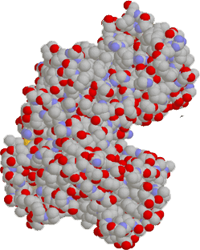
Enzymes
Enzymes are specific.
Enzymes have a specific region where the substrate binds and where catalysis occurs. This is called the active site.
The active site is usually a cleft or pocket at the surface of the enzyme. Substrate modification occurs at the active site.
The shape and the chemical environment inside the active site permits a chemical reaction to proceed more easily.
Space filling model of the yeast enzyme hexokinase. Its active site lies in the groove (arrowed).
Notes:
They are proteins so they have a specific shape which mean they can bind with a specific reactant (called the substrate).

Slide 8
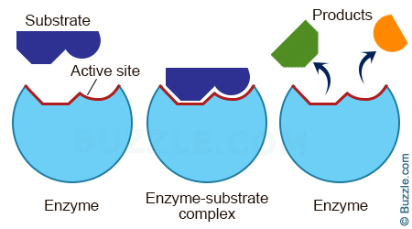
Enzyme - Substrate
In a reaction, we have the enzyme that reacts with a substrate. The enzyme and substrate bonded together is called the enzyme-substrate complex. After completion, the enzyme releases the products.

Slide 9
Enzymes
Enzymes are substrate-specific, although specificity varies from enzyme to enzyme:
  High specificity: The enzyme will only bind with a single type of substrate.
  Low specificity: The enzyme will bind a range of related substrates, e.g. lipases hydrolyze any fatty acid chain.
When a substrate binds to an enzyme’s active site, an enzyme-substrate complex is formed.
Enzymes are often named ‘ –ases’ and are named according to the substrate they catalyse.
Notes:
Naming convention – enzymes are often -ases and are named according to the substrate they catalyse.

Slide 10

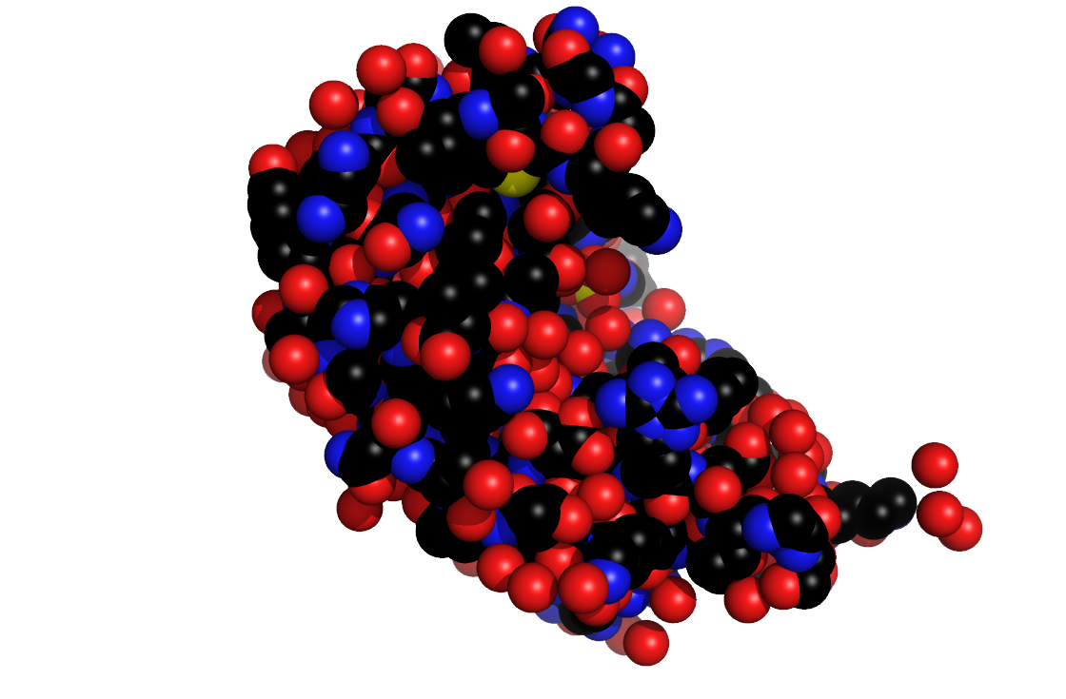
Enzyme Active Site
Substrate molecule:
Substrate molecules are the chemicals that an enzyme acts on. They are drawn into the cleft of the enzyme.
Active site:
The active site contains both binding and catalytic regions. The substrate is drawn to the enzyme’s surface and the substrate molecule(s) are positioned in a way to promote a reaction: either joining two molecules together or splitting up a larger one.
Enzyme molecule:
The complexity of the active site is what makes each enzyme so specific (i.e. precise in terms of the substrate it acts on).
This model (above) is an enzyme called Ribonuclease S, that breaks up RNA molecules. It has three active sites (arrowed).

Slide 11
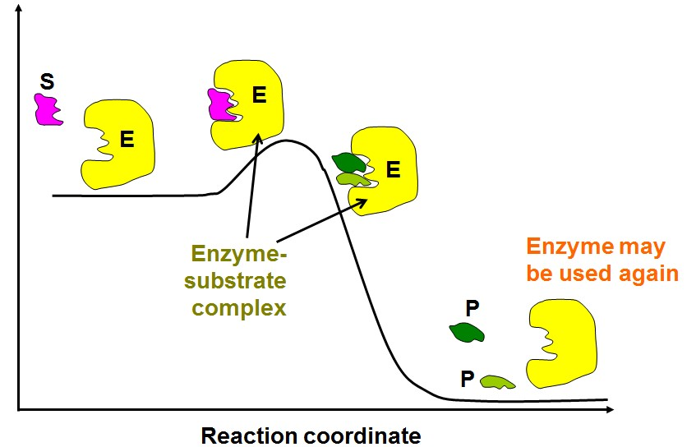
Lock and Key Model
The lock and key model of enzyme action, proposed earlier this century, proposed that the substrate was simply drawn into a closely matching cleft on the enzyme molecule, like a lock and key.

Slide 12







Lock and Key Model
Substrate
Products
Symbolic representation of the lock and key model of enzyme action.
A substrate is drawn into the active sites of the enzyme.
Enzyme
The substrate shape must be compatible with the enzymes active site in
order to fit and be reacted upon.
The enzyme modifies the substrate. In this instance the substrate is
broken down, releasing two products.

Slide 13


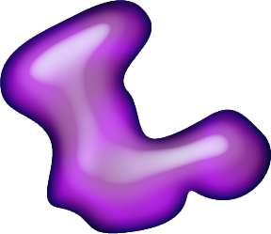

Induced-Fit Model
Two substrate molecules are drawn into the cleft of the enzyme.
More recent studies have revealed that the process is much more likely to involve an induced fit.
  The enzyme or the reactants (substrate) change their shape slightly.
  The reactants become bound to enzymes by weak chemical bonds.
  This binding weakens bonds within the reactants themselves, allowing the reaction to proceed more readily.
The enzyme changes shape, forcing the substrate molecules to combine.
The resulting end product is released by the enzyme which returns to its normal shape, ready to undergo more reactions.

Slide 14
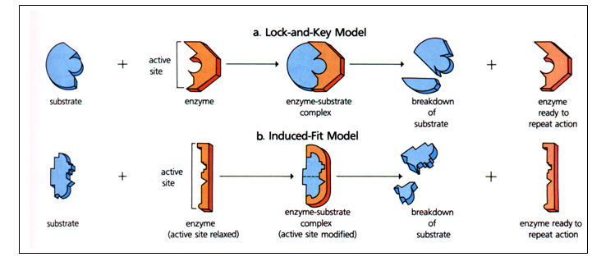
Lock and Key vs Induced Fit Model
Lock-and-key model: The substrate is an exact fit for the enzyme active site.
Induced-fit model of enzyme action: Bonds that form between an enzyme and its substrate can modify the shape of the enzyme so that the substrate can be fully accommodated by the enzyme.
  Bonds within the substrate molecule are stretched and bent by the molecular interactions with the amino acid groups that line the active site.
  Bond stresses on the substrate, lowering the activation energy required to kick-start the reaction.

Slide 15
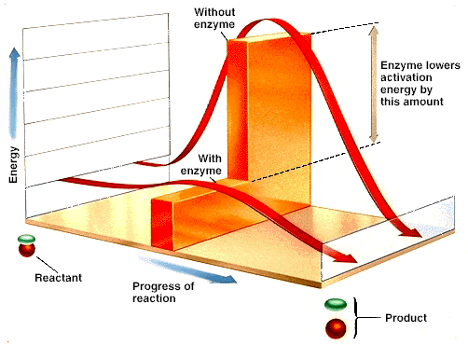
Enzymes
Enzymes are catalysts.
Catalysts make it easier for a reaction to take place.
Catalysts speed up reactions by influencing the stability of bonds in the reactants.
They may also provide an alternative reaction pathway, thus lowering the activation energy needed for a reaction to take place.

Slide 16
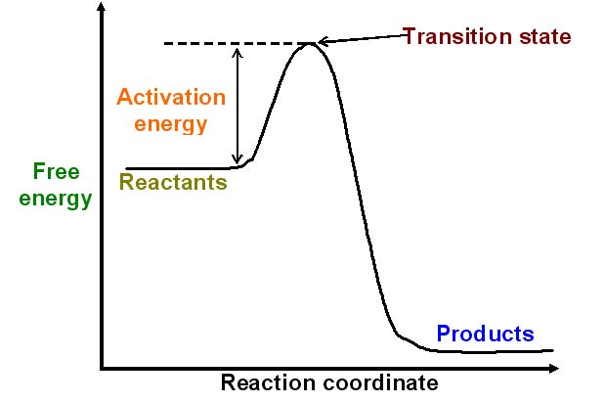
Reaction Rate
Chemical reactions need an initial input of energy = the activation energy
During this part of the reaction the molecules are said to be in a transition state.

Slide 17
Reaction Rate
Increasing the temperature causes molecules to move faster.
Biological systems are very sensitive to temperature changes.
Enzymes increase the rate of reaction without increasing the temperature.
They do this by lowering the activation energy.
They create a new reaction pathway - “a short cut”.

Slide 18


Activation Energy
Enzyme-controlled reactions proceed 108 to 1011 times faster than corresponding non-enzymic reactions.
High
Without enzyme: The activation energy required is high.
Reactant
With enzyme: The activation energy required is lower.
Amount of energy stored in the chemicals
High energy
Product
Low energy
Low
Start
Finish
Direction of reaction

Slide 19

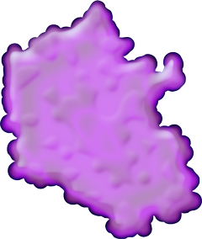





Catabolic Reactions
1. The substrate binds to the enzyme’s active site.
Catabolic reactions involve the breakdown of a larger molecules into smaller components, with the release of energy (they are exergonic).
Enzymes involved in catabolic reactions can cause a single substrate molecule to be drawn into the active site.
Chemical bonds are broken, causing the substrate molecule to break apart to become two separate molecules.
Catabolic reactions include:
    Digestion: Breakdown of large food molecules.
    Cellular respiration: Oxidative breakdown of fuel molecules such
    as glucose.
2. The substrate is subjected to stress, which facilitates the breaking of bonds
Enzyme
3. The substrate is cleaved and the two products are released to allow the enzyme to work again.

Slide 20

Anabolic Reactions
1. The substrate binds to the enzyme’s active site.
2. The substrate is subjected to stress, which will aid the formation of bonds.
In anabolic reactions, smaller molecules are joined to form larger ones.
These reactions are endergonic;
they require the input of energy.
Enzymes involved in anabolic reactions can cause two substrate molecules
to be drawn into the active site.
New chemical bonds are formed resulting in the formation of a single molecule.
Example includes:
    Protein synthesis: Build up of polypeptides from amino acids.
Enzyme
3. The two substrate molecules form a single product, which is released, freeing the enzyme to work again.

Slide 21
Factors Affecting Enzymes
Enzymes are very sensitive and have many factors which can affect their action.
These include:
    Temperature
    pH
    Substrate/enzyme concentration
    Co-factors
    Inhibitors

Slide 22
Enzyme Videos
View in your own time:
Fun song about enzymes https://www.youtube.com/watch?v=deFQhPurj-k
Practicals demonstrating the factors effecting enzyme activity https://www.youtube.com/watch?v=3b7Nuy0Xuuw

Slide 23

Learning Intentions
Understand:
biochemical processes in the cell are controlled by factors, including the nature and arrangement of internal membranes, and the presence of specific enzymes
Models used to explain the function of enzymes.
Success Criteria
Students will be able to:
Explain how enzyme function is effected by temperature, pH, presence of inhibitors, concentrations of reactants and products
Describe and illustrate the lock and key model and the induced fit model of enzyme action.

Slide 24

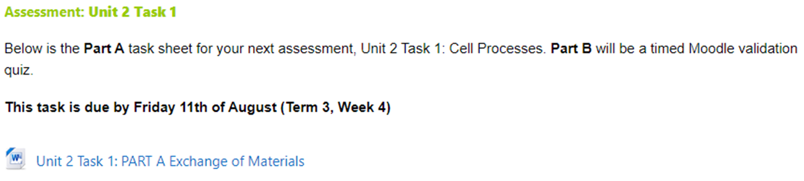
Moodle & Textbook Work
Read Nelson pages 312-322 and complete question sets 10.2-10.4.
Task due this FRIDAY! Parts A & B

Slide 25
Student Feedback
What I learnt today…..
What I need to revise….

Slide 27
Factors Affecting Enzymes
Enzymes are very sensitive and have many factors which can affect their action.
These include:
    Temperature
    pH
    Substrate/enzyme concentration
    Co-factors
    Inhibitors

Slide 28
Effect of Temperature
Enzymes often have a narrow range of conditions under which they operate properly.
For most plant and animal enzymes, there is little activity at low temperatures.
  Enzyme activity increases with temperature, until the temperature is too high for the enzyme to function.
  (See diagram right).
  At this point, enzyme denaturation (breakdown) occurs and the enzyme can no longer function.
Optimum temperature for the enzyme
Rapid denaturation at high temperatures
Rate of reaction
Too cold for the enzyme to operate
Temperature (°C)

Slide 29
Effect of pH
Enzymes can be affected by pH. All enzymes have an optimum pH they will function best at.
  Extremes of pH (very acid or alkaline) away from the enzyme optimum can result in enzyme denaturation.
Enzymes are found in very diverse pH conditions, so they must be suited to perform in these specific environments.
  Pepsin is a stomach enzyme and has an optimal working pH of 1.5, which is suited for the very acidic conditions of the stomach.
  Urease breaks down urea and has an optimal pH of near neutral. See diagram right.
Pepsin
Urease
Trypsin
Enzyme activity
1
2
3
4
5
6
7
8
9
10
Acid
Alkaline
pH
Enzymes often work over a range of pH values, but all enzymes have an optimum pH where their activity rate is fastest.

Slide 30
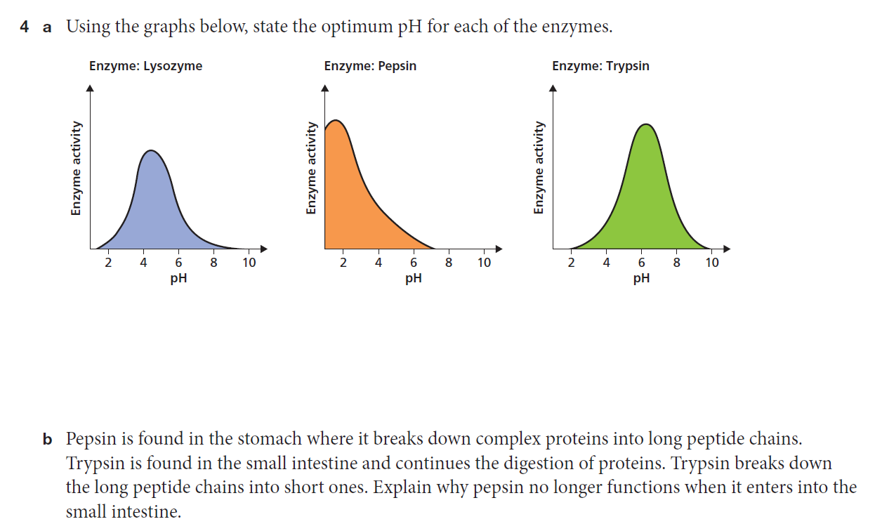

Slide 31
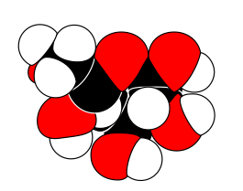
Concentration
Effect of Enzyme Concentration
Effect of Substrate Concentration
Rate of reaction
Enzyme concentration
Concentration of substrate
Rate of reaction continues to increase
with an increase in enzyme concentration.
This relationship assumes non-limiting amounts of substrate and cofactors.
Rate of reaction increases and then plateaus with increasing substrate concentration.
This relationship assumes a fixed amount
of enzyme.
Notes:
Amount of substrate or enzyme present in a reaction mix can limit the amount of products produced.
Increased amounts of substrate will result in more products being made until all the enzyme molecules are working at their full capacity.
When amount of enzyme is increased the amount of product will continue to increase exponentially. This keeps happening until the product starts to inhibit the reaction or the substrate is depleted.
Concentrations controlled in response to the needs of the cell by either controlling the production of the protein, breaking down the enzyme or by activating the enzyme with a stimulus. Pepsinogen inactive form pepsin active form occurs when entering the acidic environment of the stomach.

Slide 32


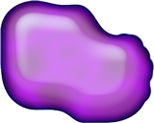


Enzyme Cofactors
Active site
Enzyme is protein only
Example: lysozyme
Some enzymes require cofactors to be active.
Cofactors are a non-protein component of an enzyme.
Cofactors can be:
  organic molecules (coenzymes).
  inorganic ions (eg. Ca²⁺, Zn²⁺).
Cofactors may be:
  Permanently attached, in which case they are called prosthetic groups.
  Temporarily attached coenzymes, which detach after a reaction, and may participate with another enzyme in other reactions.
Enzyme
Active site
Prosthetic group
Enzyme + prosthetic group
Example:
flavoprotein + FAD
Enzyme
Active site
Enzyme + coenzyme Example:
dehydrogenases + NAD
Coenzyme
Enzyme

Slide 33
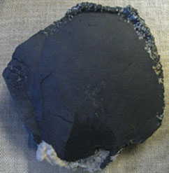
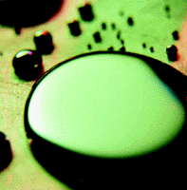
Enzyme Inhibitors
Native arsenic
Enzymes can be deactivated by
enzyme inhibitors.
Types of enzyme inhibitors:
  Reversible inhibitors: used to control enzyme activity. There is often an interaction between the substrate or end product and the enzymes controlling the reaction.
  Irreversible inhibitors: bind tightly and permanently to the enzymes destroying their catalytic activity.
  Competitive inhibitors: have a similar shape to the substrate and bind to the active site preventing the substrate from binding there.
  Non-competitive inhibitors: the inhibitor binds to a site somewhere on the enzyme other than the active site. This causes the shape of the active site to change, meaning that the substrate cannot bind.
Mercury
Photo: US EPA
Some heavy metals (above) are examples of poisons which act as irreversible enzyme inhibitors.
Notes:
Feedback inhibition – the product of a reaction can inhibit enzyme activity. If a large amount of product is present it will act as an inhibitor by binding to a site on the enzyme and changing the shape of the active site so it can no longer continue the reaction with the substrate. (noncompetitive)

Slide 34
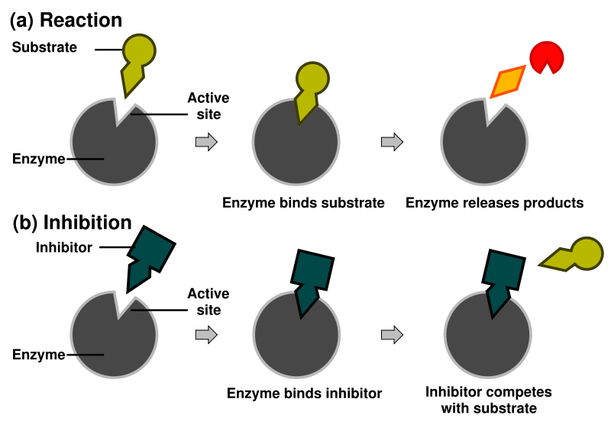
Enzyme Inhibitors

Slide 35
Enzyme Videos
View in your own time:
Fun song about enzymes https://www.youtube.com/watch?v=deFQhPurj-k
Practicals demonstrating the factors effecting enzyme activity https://www.youtube.com/watch?v=3b7Nuy0Xuuw

Slide 36
Learning Intentions
Understand:
biochemical processes in the cell are controlled by factors, including the nature and arrangement of internal membranes, and the presence of specific enzymes
Models used to explain the function of enzymes.
Success Criteria
Students will be able to:
Explain how enzyme function is effected by temperature, pH, presence of inhibitors, concentrations of reactants and products
Describe and illustrate the lock and key model and the induced fit model of enzyme action.

Slide 37
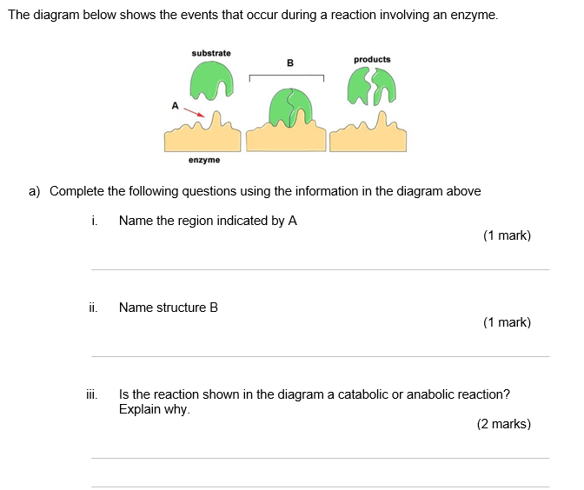
Exam Review Question
Notes:
Active site
Enzyme substrate complex
Catabolic
It shows a larger molecule being broken down into smaller ones

Slide 38
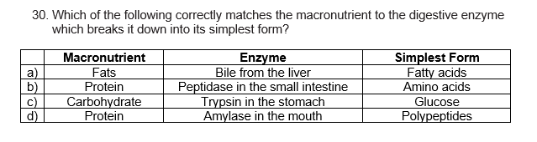
Notes:
B

Slide 39
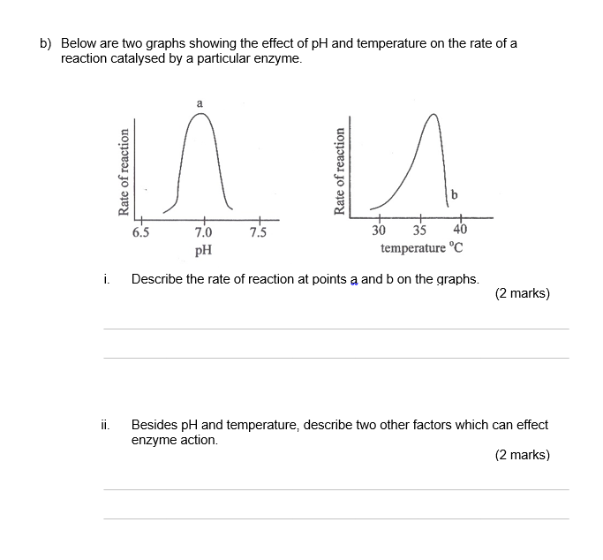
Notes:
A – optimal/ fastest rate of reaction
B – very slow reaction rate
Increase concentration of enzyme = increase rate
Cofactors may be required for enzyme to function
Inhibitors stop enzyme action

Slide 40
Moodle & Textbook Work
Read Nelson pages 312-322 and complete question sets 10.2-10.4.
Task due this FRIDAY! Parts A & B

Slide 41
Student Feedback
What I learnt today…..
What I need to revise….

